Slide 1

Devi Mahalaxmi Polytechnic College, Titwala Departments of Computer Engg Academic Year: 2022-23
AI Voice Assistant
Presented by
Mr. HARSH NANDLAL YADAV
Mr. SAHIL SHEKAR KADAM
Mr. VIJAY NARKAR SAMBHAJI
Mr. JITESH RAMDAS GAWDE
Notes:
This template can be used as a starter file for presenting training materials in a group setting.
Sections
Right-click on a slide to add sections. Sections can help to organize your slides or facilitate collaboration between multiple authors.
Notes
Use the Notes section for delivery notes or to provide additional details for the audience. View these notes in Presentation View during your presentation.
Keep in mind the font size (important for accessibility, visibility, videotaping, and online production)
Coordinated colors
Pay particular attention to the graphs, charts, and text boxes.
Consider that attendees will print in black and white or grayscale. Run a test print to make sure your colors work when printed in pure black and white and grayscale.
Graphics, tables, and graphs
Keep it simple: If possible, use consistent, non-distracting styles and colors.
Label all graphs and tables.

Slide 2

Content
Introduction of Ai voice assistant
What is AI
What is voice assistant
Overview of the project
Object of the project
Design and Development
UI design
Flowchart
Python Module
How it works
Example
Features
Hardware and Software
Future scope
Conclusion
Reference
Notes:
This is another option for an Overview slides using transitions.

Slide 3
INTRODUCTION OF
AI VOICE ASSISTANT

Slide 4

What is AI?
"AI stands for Artificial Intelligence, where 'Artificial' means made by humans, and 'Intelligence' refers to the ability to make decisions or think."

Slide 5

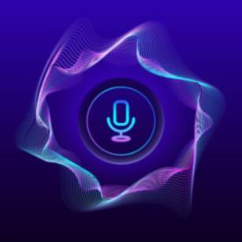
What is Voice Assistant ?
A Voice Assistant is an artificial intelligence tool designed to respond to user speech commands and execute tasks, providing a hands-free and convenient interaction with technology.

Slide 6
Overview of project
The purpose of this application uses speech recognition technology to interpret the user's voice commands and execute them. Once the user interacts with the assistant, it greets the user with a welcome message and awaits further instructions. The assistant can perform various tasks such as sending an email, taking a screenshot, opening a website, scheduling an email, and answering questions with the help of OpenAI. The user can interact with the assistant using voice commands, and the assistant responds with spoken words.

Slide 7
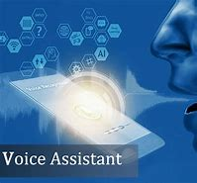
Objectives
The main purpose of an intelligent voice assistant is to answer the questions that users may have.
The assistant is designed to provide personalized assistance to users in various domains, including email, web browsing, scheduling, taking photos, and answering general questions. The project aims to make the assistant user-friendly, interactive, and efficient to help users save time and be more productive. The project utilizes various technologies, including speech recognition, text-to-speech conversion, and artificial intelligence, to create an intelligent personal assistant that can understand and respond to user queries in natural language.
Notes:
What will the audience be able to do after this training is complete? Briefly describe each objective how the audience will benefit from this presentation.

Slide 8
Design and Development
Notes:
Use a section header for each of the topics, so there is a clear transition to the audience.

Slide 9
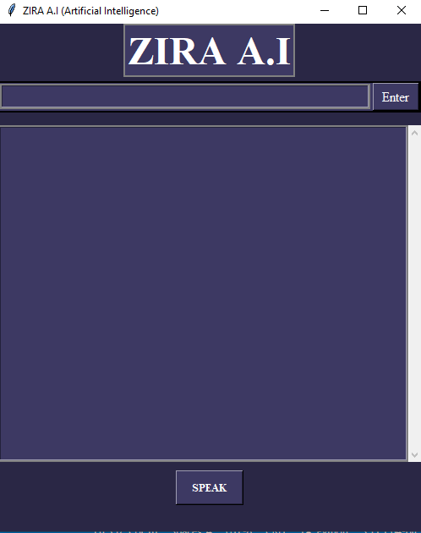
User Interface(UI) Design
Notes:
Add slides to each topic section as necessary, including slides with tables, graphs, and images.
See next section for sample table, graph, image, and video layouts.

Slide 10
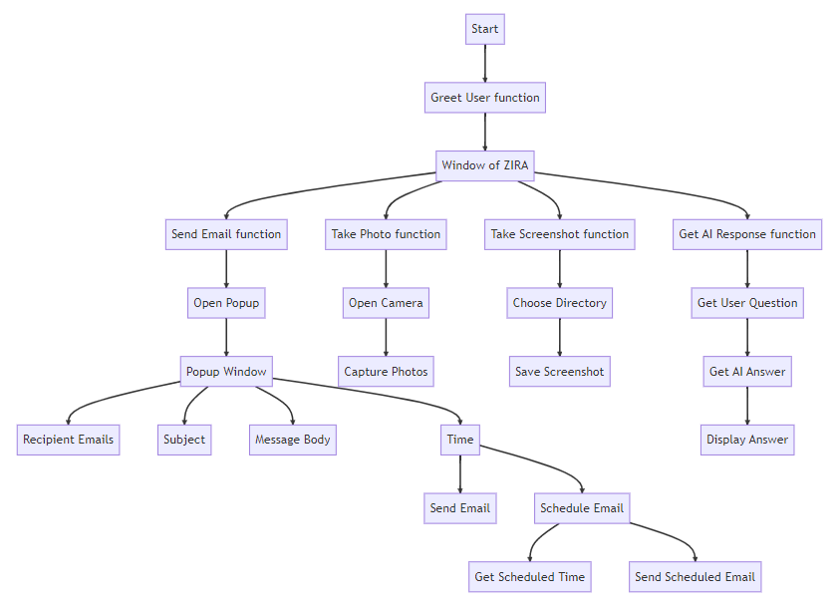
Flowchart
Notes:
Keep it brief. Make your text as brief as possible to maintain a larger font size.

Slide 11
Python Module
The module used in the project are give below:
1. `tkinter` for building the GUI application
2. `filedialog` from `tkinter` for opening file dialogs
3. `messagebox` from `tkinter` for showing pop-up message boxes
4. `schedule` for scheduling email sending
5. `smtplib` for sending emails
6. `time` for timing the scheduled emails
7. `requests` for making HTTP requests
8. `datetime` for getting the current date and time
9. `openai` for generating AI responses to user queries
10. `speech_recognition` for recognizing speech from the microphone
11. `pyttsx3` for converting text to speech
12. `webbrowser` for opening webpages in a browser
13. `pywhatkit` for sending WhatsApp messages
14. `pyautogui` for taking screenshots
15. `cv2` from OpenCV for accessing the webcam and taking photos.

Slide 12
How It Work
It take command form user (it can take command either text or speech).
If user ask any question then it generate the response by using OpenAI module.
If user command say “Activate email mode” then it show a popup window that ask user to write receiver email id , subject ,body and time to send email(it is optional).
Similarly, if user commend say “take a photo” , “weather mode” or “take screenshot” then it open a window and preform that task.
If user command say “play (song name) song” then it open YouTube and that song.
It can preform more take such as opening website, text to speech, speech to text ,write a program, letter, poem, etc.

Slide 13
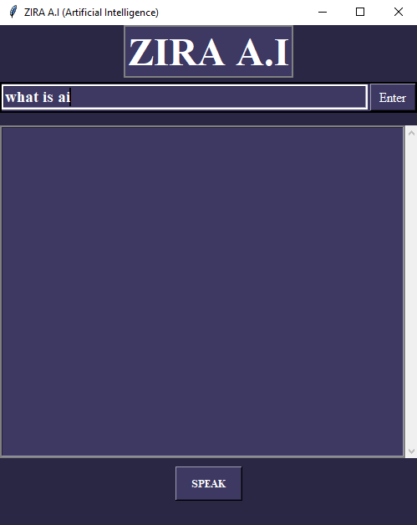
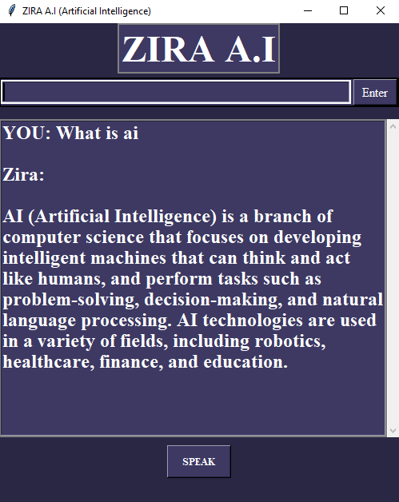
Example :
Notes:
If there is relevant video content, such as a case study video, demo of a product, or other training materials, include it in the presentation as well.

Slide 14
Feature
1
We can send Email, check the weather
3
We can take screenshot, photo
2
We can get answer the question that we have.
4
We can play any song.
We can open website like Google, Facebook, etc.
5
Notes:
This is another option for an Overview slide.

Slide 15
Hardware And Software
Here are the hardware and software used in the project:
Hardware:
Intel(R) Core(TM) i5-4200U CPU @ 1.60GHz 2.30 GHz
RAM 4GB.
64-bit operating system, x64-based processor
Software:
Windows 10 Pro
Python 3.11.1
Visual studio code
Notes:
Add a case study or class simulation to encourage discussion and apply lessons.

Slide 16
Future Scope
The GUI can be further improved by making it more intuitive and user-friendly.
Adding more functionality such as calendar scheduling, task management, and book travel arrangements, etc.
Integrating the virtual assistant with smart home devices
Adding multilingual support for users who speak languages other than English
Notes:
Discuss outcomes of the case study or class simulation.
Cover best practices.

Slide 17
Conclusion
In conclusion, this project demonstrates the power of Python programming language and its libraries in building a virtual assistant. With the use of Tkinter, schedule, smtplib, OpenAI, speech_recognition, pyttsx3, webbrowser, pywhatkit, pyautogui, and cv2, we were able to create a fully functional virtual assistant that can perform tasks such as sending emails, scheduling emails, opening web pages, taking screenshots, and even capturing photos through the webcam. This project can serve as a starting point for those who want to build their own virtual assistants, and can be further enhanced with additional functionalities and features. Overall, the project is a testament to the versatility and flexibility of Python as a programming language.
Notes:
Summarize presentation content by restating the important points from the lessons.
What do you want the audience to remember when they leave your presentation?
Save your presentation to a video for easy distribution (To create a video, click the File tab, and then click Share. Under File Types, click Create a Video.)

Slide 18
References:
https://openai.com/
https://openweathermap.org/
https://mermaid.live/
https://www.tutorialspoint.com/python/index.htm
https://docs.python.org/3/tutorial/
YouTube References:
https://www.youtube.com/@CodeWithHarry
https://www.youtube.com/@wscubetech
https://www.youtube.com/@codinglifestyle4u
https://youtu.be/IhRfqiC29D

Slide 19
Thank You

